Slide 1
Water Health Partnership Conference 2023

Slide 2
Welcome
Sharon Evans
Director of Quality, Policy and Compliance, Dŵr Cymru Welsh Water
Chair of Water Health Partnership Steering Group
Chair of morning session

Slide 3
Housekeeping
No fire alarm tests – evacuation arrangements
Facilities
Mobile Phones
Timekeeping

Slide 4
Mission Statement of the WHP:
Protecting and enhancing public health by working together to deliver consistent understanding and management of water quality issues and to supply safe & resilient water services.

Slide 5
Aims of the WHP
Facilitate improved communication and data sharing between public health practitioners
Delivering against the objectives of the Wellbeing of Future Generations Act 2015
Provision of consistent communication and messaging on public health issues within scope
Initiate events, training, CPD and raise awareness of health issues related to public and private water services and associated topics of interest
Undertake specific supporting activities through the work of multi-agency working groups

Slide 6
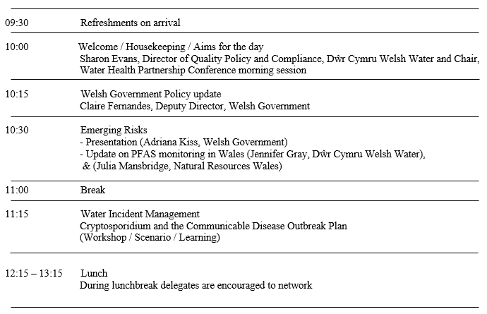
Agenda

Slide 7
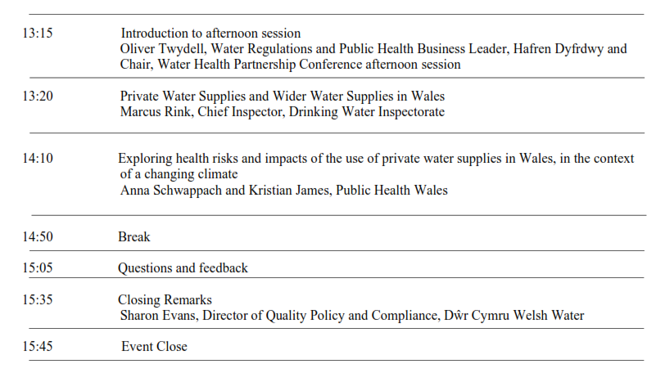
Agenda

Slide 8
Rules for the day
Interact
Engage
Enjoy

Slide 9
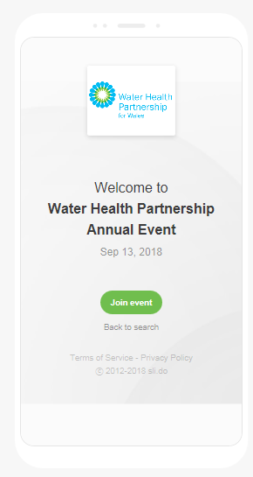
Slido Questions/ Feedback
How to join the event
Open a browser on any laptop, tablet or smartphone
Go to slido.com
Enter the event code #WHP2023
9 Nov 2023

Slide 10
Water Health Partnership Annual Conference
Policy Update from the Welsh Government
9 November 2023
Clare Fernandes
Deputy Director for Water and Flood

Slide 11
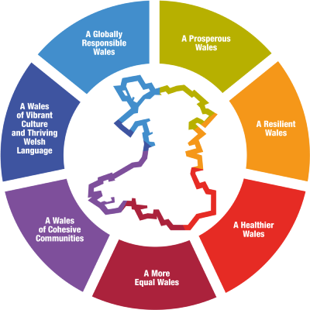
Strategic Context and Policy Drivers
Programme for Government
Embed our response to the climate and nature emergency in everything we do
The well-being objectives have been set in accordance with the sustainable development principle and the 5 ways of working:
Long term
Integration
Involvement
Collaboration
Prevention
Begin to designate Wales’ inland waters for recreation, strengthening water quality monitoring.
Legislate to strengthen the requirements for the use of sustainable drainage systems that provide wildlife habitat.
The Well-being of Future Generations Act 2015 - 7 Wellbeing Goals
Healthy water environment, safe clean water and sufficient supply underpins all the wellbeing goals

Slide 12
Current State of Wales’ Waters
A team Wales approach is required to deliver at scale and pace to realise our ambitions for nature and the climate, and we must each understand our role for delivery. A thriving water environment is essential for supporting healthy communities, flourishing businesses and biodiversity. To enable this, we need to reduce the pressure on our water environment…
Oral Statement on Water Quality by Julie James MS, Minister for Climate Change, Senedd 15 November 2022
Excellent drinking water quality (99.97% compliance with statutory standards for mains supply)
40% of waterbodies at good or better ecological status, with 44% of rivers achieving this classification under WFD
93% of waterbodies at good or better chemical status
109 designated bathing waters (mostly coastal) 99% were classed as sufficient or better in 2022.
61% of Special Areas of Conservation rivers not meeting Phosphorus standards (NRW data 2021)
Pollution concerns: agricultural run-off, wastewater discharges, industrial pollution, abandoned metal mines

Slide 13
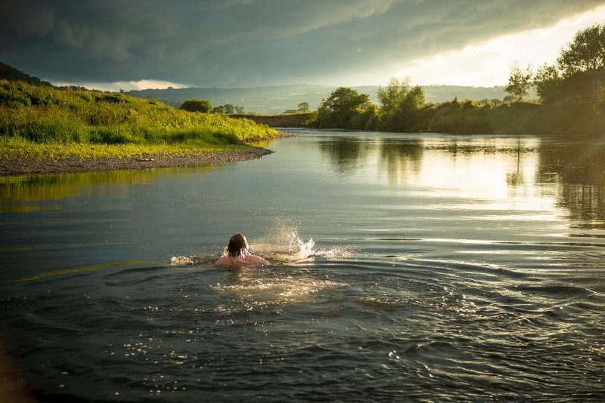
Programme for Government Commitments
Sustainable Drainage Systems (SuDS)
SuDS relieve pressures on the network by redirecting and slowing down surface water
Mandatory SuDS on new building developments
Enhancing the SuDS legislative framework will provide additional environmental, biodiversity, well-being and economic benefits
Inland Bathing Waters
We have identified 7 inland waters that we will use to pilot a new approach to bathing waters. These sites are a mixture of lakes, reservoirs and rivers
NRW are responsible for delivering the pilot
Public surveys have been issued to gather evidence and support policy development
Water Quality Monitoring
Supporting NRW’s freshwater monitoring review
Collaboration with other stakeholders such as water companies and academia on data sharing

Slide 14
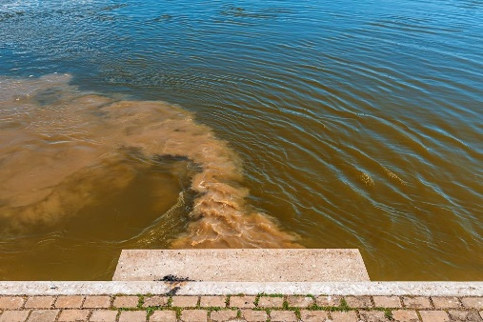
Challenges and Pressures
Water quality and pollution have been making headlines
Water Policy work is driven by the increased attention on specific issues, such as Combined Storm Overflows (CSO) and Phosphorus pollution in Special Areas of Conservation (SAC) rivers
Collaborative working to address the challenges
Better River Quality Taskforce - evaluates management and regulation of CSOs
Storm overflow evidence for Wales report published on 26 October; link: rpt_ (gov.wales)
2 River Pollution Summits; 3rd planned for 30 November
Action Plan - Relieving pressures on SAC river catchments to support delivery of affordable housing: Relieving pressures on Special Areas of Conservation (SAC) river catchments to support delivery of affordable housing: action plan [HTML] | GOV.WALES

Slide 15
Drinking Water Quality
Drinking Water 2022: The Chief Inspector’s report for drinking water in Wales (mains supply)
Overall compliance with the standards in the Water Supply (Water Quality) Regulations 2018 (the Regulations) in 2022 was 99.97%
There were 68 breaches of standards in 2022
Iron breaches made up the largest part (44%) – 21 iron breaches in total
The largest breach was a single coliform breach at Dŵr Cymru Welsh Water’s Ponsticill treatment works in September 2022
There were 20 coliform breaches and one E. coli breach
There has been an increase in turbidity breaches at treatment works
Private Water Supplies (PWS)
Approximately 75,442 people are on PWS (DWI)
Uncertainty over number and location – estimate around 15,000 in Wales
PWS are extremely vulnerable to climate change – loss of supply in prolonged dry conditions and possible contamination during heavy rain

Slide 16
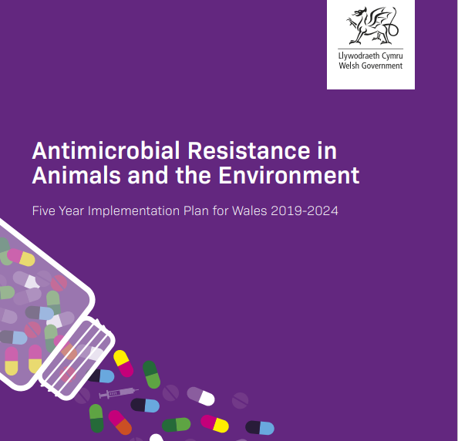
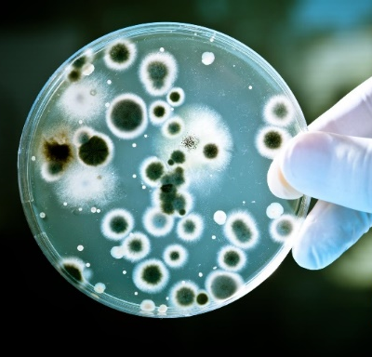
AMR in the Water Environment
AMR is a global prevalent public health threat, responsible for around 4.95 million deaths per year
There is expanding evidence that humans can be exposed to environmental microbes carrying AMR, therefore an increase in any AMR entering the environment is a concern to human, animal and environmental health.
In 2019, the UK Government published its 5-year AMR National Action Plan (NAP) with a specific commitment on AMR in water:
Explore the establishment of a river catchment based research programme with clear standards for sample collection, analysis and review, with the aim of delivering AMR monitoring data that can be used to evaluate existing management interventions and inform any new policy initiatives.
The NAP commitment is underpinned by the Welsh Government’s AMR in Animals and the Environment - Five Year Implementation Plan for Wales 2019-2024. The Water Policy team in the Welsh Government is responsible for meeting the Ministerial commitment.
A main goal is to minimise spread of AMR through the environment.

Slide 17
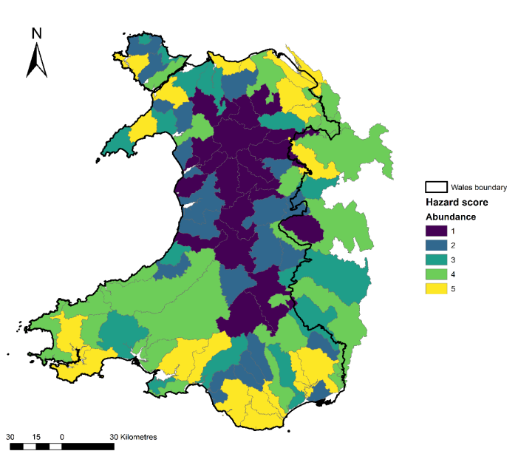
Delivering the AMR Commitment
AMR in the Environment UK CEH study (2021-2024)
Phase 1 - Evidence Review
Lack of basic surveillance data in Welsh freshwater environments means that there is no empirical evidence to show the extent of the problem
Phase 2 - Hazard Maps
Part of the evidence-gathering phase to understand the sources and sinks of Antimicrobial Resistance Driving Chemicals (ARDC) and Antibiotic Resistance Genes (ARG) on a national scale in Wales. The geospatial datasets will help to inform future AMR monitoring campaigns within Wales.
Antimicrobial Resistance | ERAMMP
Next steps
We are working with Bangor University at present to progress a series of projects to meet the AMR commitment. As Bangor University is the main delivery partner for the Welsh Government Wastewater Monitoring Programme that focuses on COVID, other pathogens and AMR, the university has the required expertise and equipment to lead on this work.

Slide 18
Other Updates
Phosphorus Summit to manage SAC Rivers - 30 November
Oral Statement on Water Quality by the Minister for Climate Change – 12 December
Emerging threats to water quality – workshop in Cardiff on 20 November.
Bathing waters – the 2023 results are expected to be published by the end of this year
Water monitoring – collaborative exploration of a shared platform with academics, NGOs, water companies and other stakeholders

Slide 19
Water Health Partnership Annual Conference
Emerging Threats to Water Quality Working Group
Dr Adriana Kiss
Senior Water Policy Advisor
Welsh Government

Slide 20
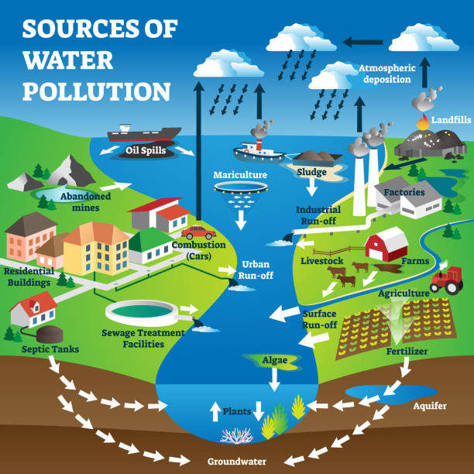
New and emerging pollutants present a global water quality challenge with potentially-serious threats to human health and ecosystems (UNESCO)
Main causes of water quality failures in Wales: physical modification, agricultural diffuse pollution, urban pollution, sewage discharges and pollution caused by abandoned metal mines
Challenge of managing legacy pollutants and emerging contaminants

Slide 21
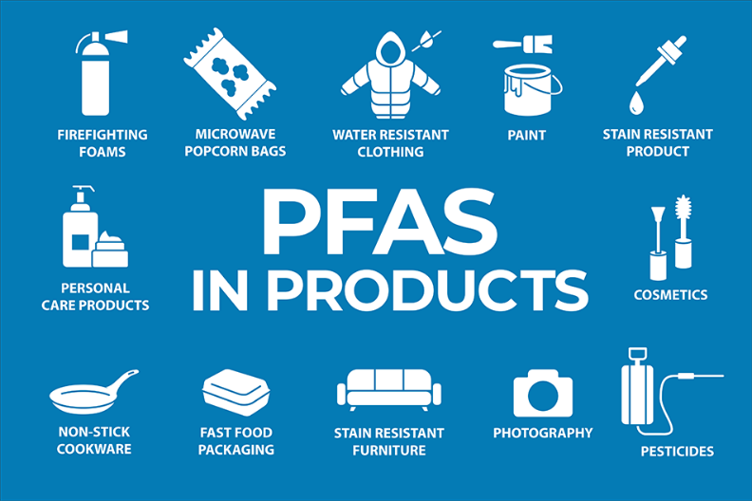
Drinking and Environmental Water Quality
Personal care products
Forever chemicals (PFAS)
Plastics
Pesticides
Pharmaceuticals and veterinary products
Endocrine disruptors
The term ’emerging contaminant’ is used to describe a substance that is not yet regulated but may be of environmental or human health concern. (BGS)
Could be synthetic or naturally occurring
Not commonly monitored and have no statutory standards
Potential to enter the environment
Known or suspected adverse ecological and/or human health effects
Need to be managed proactively to prevent harm
Understand the use of these contaminants
Understand the pathways and how they behave in the water environment
Need to assess the risk they present to the environment, wildlife and human health
Collate evidence to put in place policy and regulatory interventions

Slide 22
Emerging Threats to Water Quality Working Group
Started as an informal gathering and discussions between Natural Resources Wales (NRW) and Welsh Government policy teams
Initially based on NRW’s chemicals investigation programme (passive monitors) and its findings
Managed by Welsh Government Water Policy with support from NRW
Placed on a more formal footing with a Terms of Reference in 2022
Regular monthly/bi-monthly online meetings
The group’s main objective is to identify chemical substances and associated issues, such as AMR and microplastics, which present a threat to water quality in Wales and assist the Welsh Government’s long-term policy development
Workshop scheduled for 20 November in Cardiff

Slide 23
Seek to achieve integrated long term solutions and take account of the short, medium and long term consequences of actions
Consider how we can do things differently and better
Prevention
Take account of all relevant evidence
Work with integrity and respect
Long Term
Integration
Work collaboratively – across organisations, but also with other stakeholders and group members
Collaboration
Engagement
Share information and research in confidence

Slide 24
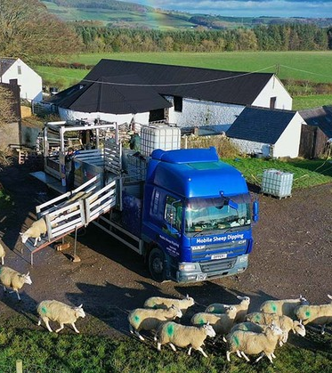
What did we find?
PFAS and Microplastics
NRW Chemicals Investigation Programme provides an interesting and useful dissection of society (nicotine, caffeine and lifestyle drugs)
Pharmaceuticals represent a high proportion of substances found in water in Wales
Diazinon (sheep dip) specific concern for Wales
Emerging threats is a fast-evolving area
Lots of interest at Wales and UK level
Complex issues – mixtures and interactions

Slide 25
Next Steps
Influence policy development in Wales
Influence policy developments at UK level
Identify chemicals of emerging concern and identify actions to ensure a high level of environmental protection
Support monitoring and evidence needs
Identify evidence gaps
Set up subgroups to focus on Wales-specific issues
Contribute to the development of policy and legislative interventions
Increase integration and collaboration

Slide 26
Thank you
Adriana Kiss
adriana.kiss@gov.wales

Slide 27
PFAS in the Environment Water Health Partnership Conference 09/11/2023
Julia Mansbridge Natural Resources Wales

Slide 28
NRW PFAS Monitoring
9 PFAS compounds are included in NRW’s regular monitoring programme
Environmental Quality Standards set for PFOS
Biota monitoring in trout and mussels
Water monitoring in surface and groundwater
Table from: RPA (2022): PFAS Literature Review, Final report for Welsh Government, September 2022, Norwich, Norfolk, UK

Slide 29
NRW PFAS Monitoring
Graph showing an overview of NRW PFAS sampling

Slide 30
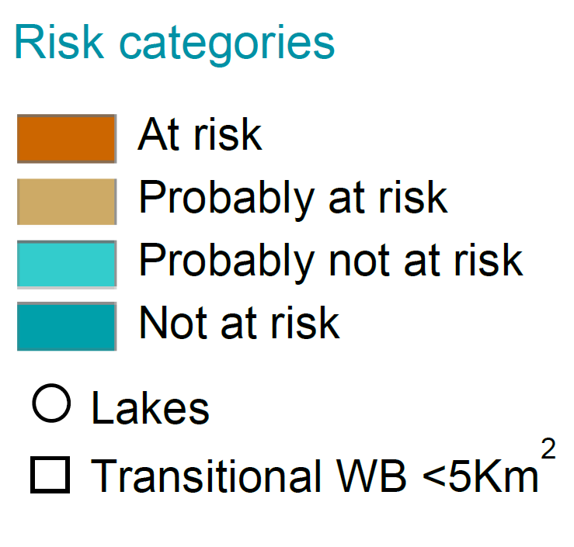
PFAS Risk Map
https://nrw.maps.arcgis.com/apps/webappviewer/index.html?id=6a1e589d397d4981bfb1158a62747818

Slide 31
Update on PFAS monitoring in Wales
Jennifer Gray Public Health Scientist, Dŵr Cymru Welsh Water

Slide 32
Tiers
Tier 1 (Low) | Tier 2 (Medium) | Tier 3 (High)
<0.01 µg/L | <0.1 µg/L | ≥0.1 µg/L
Risk Rating
Combined Dŵr Cymru Welsh Water and Hafren Dyfrdwy
Risk Rating | Number of Sites (%) 2023
Low | 103 (85.8%)
Medium | 17 (14.2%)
High | 0

Slide 33
PFAS in Raw Water
Date | PFAS Result (µg/L)
23/11/2021 | 0.011 (6:2PTS)
08/06/2022 | 0.019 (Linear PFOS) 0.022 (Total PFOS)
26/07/2022 | 0.018 (PFOA)
238 Raw water samples
4453 individual PFAS results

Slide 34
PFAS in Final Water
Date | PFAS Result (µg/L)
22/07/2022 | 0.025 (PFBA)
21/04/2023 | 0.011 (6:2PTS)
26/04/2023 | 0.012 (6:2PTS)
10/07/2023 | 0.015 (PFBA)
07/08/2023 | 0.012 (Branched PFOS) 0.018 (Linea PFOS) 0.029 (Total PFOS)
257 Final water samples
44 WTWs
4826 individual PFAS results

Slide 35
PFAS discussion/ research groups
Welsh Gov.: Emerging Threats to Water, PFAS sub-group
Isle Utilities: International Working Group
Welsh Water/NRW: Joint working Group
Cardiff University: Opportunity to link and research needs

Slide 36
Break Return to this room at 11:15 please

Slide 37
Water Incident Management
Cryptosporidium and the Communicable Disease Outbreak Plan
Workshop/ Scenario/ Learning

Slide 38
Scenario: Managing a water related outbreak incident
Why now?
Draft Outbreak Plan for Wales – review near completion
Water Incident management plan – in need of review
Purpose:
Re- familiarisation with the water incident management process and identify and discuss any opportunities for improvement.

Slide 39
The session:
Break into smaller groups for scenario (45 mins)
Each group appoint a chair and scribe
Copies of outbreak plan and water incident plan
Capture answers to 4 questions for feedback
Reconvene at 12:00 for feedback session (15 mins)

Slide 40
Workshop session
Tables 1 & 2 – Move to Cader Room 1 (Facilitator – Adriana Kiss)
Tables 3 & 4 – Move to Cader Room 1 (Facilitator –Kate Willis)
Tables 5 & 6 – Move to Cader Room 2 (Facilitator – Avril O’Gorman)
Tables 7 & 8 – Stay in this room (Facilitator – Diane Watkin)
Table 9 &10 - Move to Stay in this room (Facilitator – Julia Mansbridge)
Please be back in this main room for 12:00 for feedback session

Slide 41
Feedback on workshop session

Slide 42
Feedback questions
What were the main issues raised re. communication between stakeholders?
Any feedback on the draft Outbreak Plan and the Water Incident Management plan?
What actions and decisions were considered re. the PWS?
Identify the main sticking point or issue in your discussions and what you think needs to be done to deliver an improvement?

Slide 43
Lunch Please take the opportunity to network Return to this room ready for afternoon session at 13:15 please Or 13:00 for a quiz! (Slido required)

Slide 44
Welcome back
Oliver Twydell, Water Regulations and Public Health Business Leader, Hafren Dyfrdwy
Member of Water Health Partnership Steering Group
Chair of afternoon session

Slide 45
Agenda

Slide 46
Drinking Water
Wales 2022
Marcus Rink
Chief Inspector of Drinking Water

Slide 47
Overview
Public Water supplies in Wales
Drinking water quality compliance
Events
Discolouration
Asset Risks
Private Water Supplies in Wales
Overview
Compliance
Sampling
Case Studies
Hayslad waterspout
Aysdalegate Cottages
Trecwn - Barham Road
Notes:
Acceptability, why is there such as issue in Wales, don't cover what companies are doing as they will present on this
CCW
Ofwat ODI, what are they doing about this and what financial penalty does this incur.
Events and ERI
Drought / freeze thaw

Slide 48
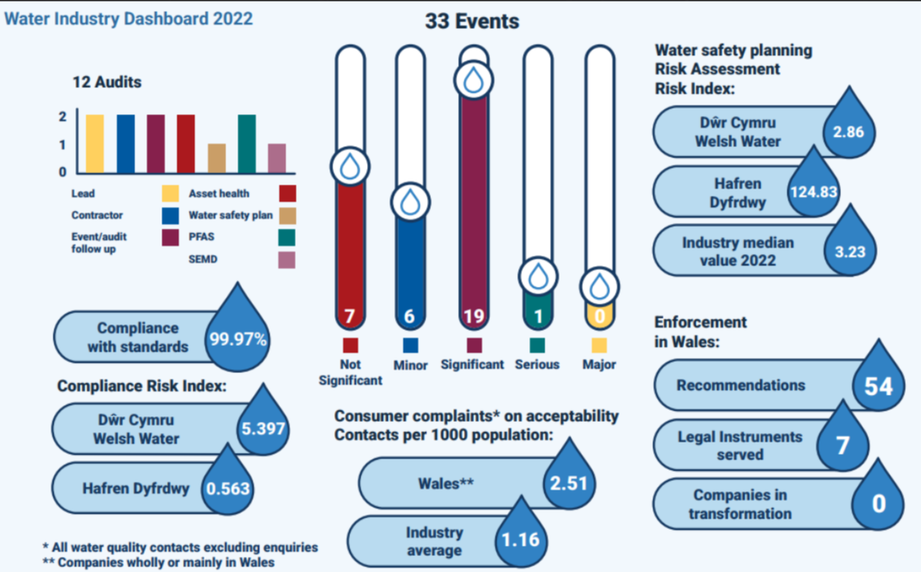
Industry dashboard

Slide 49
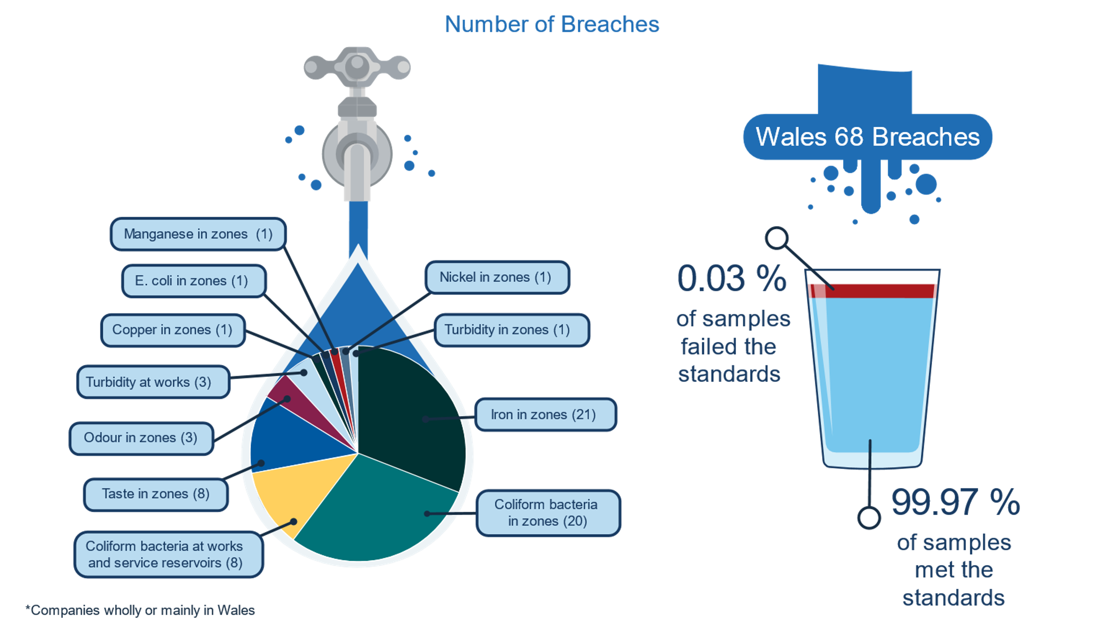
Compliance with the Standards in Wales 2022
318,184 Tests
Group | % Comp
Chem | 99.94
Indicator | 99.96
Micro | 99.99
Pesticides | 100
*WTW 61; SR 102
WTW 3, SR 5
Notes:
TL: Drinking water in England is, and continues to be, excellent by international standards. Public water supply compliance with the drinking water regulations has been consistently high for a number of years, with a rate of 99.97% in 2022. The UK is one of only six nations in the world with infrastructure considered to be sufficient to maintain public health and without an associated disease burden.
The number of samples required to be tested for lead by the Regulations is also quite low and will be a contributing factor. Companies are submitting lead reduction strategies as part of their business plans for Price Review 2024. They have set the target of being lead free within their water supply zones by 2050, however plans to achieve this target appear unambitious. Dŵr Cymru Welsh Water is developing a lead predictor model in the absence of hard data on pipe material, this utilises data on age ranges of inhabitants and focuses on the vulnerable groups to prioritise areas for replacement. It estimates approximately 180,000 lead pipes exist in the Dŵr Cymru Welsh Water area, however, its AMP8 target (2025 to 2030) is to replace 7,500. This current strategy will take over 120 years to achieve a lead-free supply. To achieve this with 180,000 replacements by 2050 the company would need to replace 7,500 each year. Hafren Dyfrdwy estimates approximately 26,000 lead pipes exist in its area, with a target of 2,000 replacements during AMP8. Again, this rate would need to be nearer 1,000 per year to achieve full lead pipe replacement. At the proposed rate this will take over 60 years to become a lead-free area. Whilst the replacement of every single lead pipe will be of benefit to public health, the target, which the majority of companies have set themselves, of being lead free by 2050 currently feels out of reach without a colossal effort from AMP9 onwards.

Slide 50
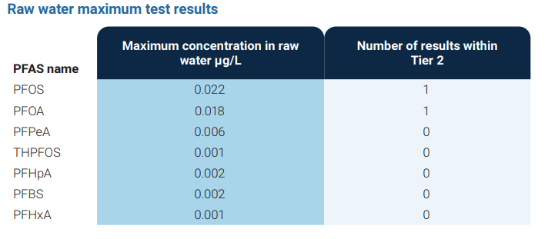
PFAS surveillance in Wales
Tier | Escalating Action
Tier 1 | Risk Assessment and Monitoring
Tier 2 | Risk Control and Consultation
Tier 3 | Risk Reduction and Notification
Notes:
TL: The presence of PFAS through analysis by companies is a clear and confirmed risk which will require clear planning for the future.
Companies should be applauded on their efforts to analyse and compile this data.
Some companies are further ahead then others. E.g. ANH have taken >120x the number of samples as TMS and this provides a clearer picture for ANH on what the risks are for them.
There are clear outliers in the risk profile such as AFW.
Companies will need to consider what actions will need to be taken for risk control but these will need to be validated and clearly controlled.

Slide 51
CRI Welsh companies

Slide 52
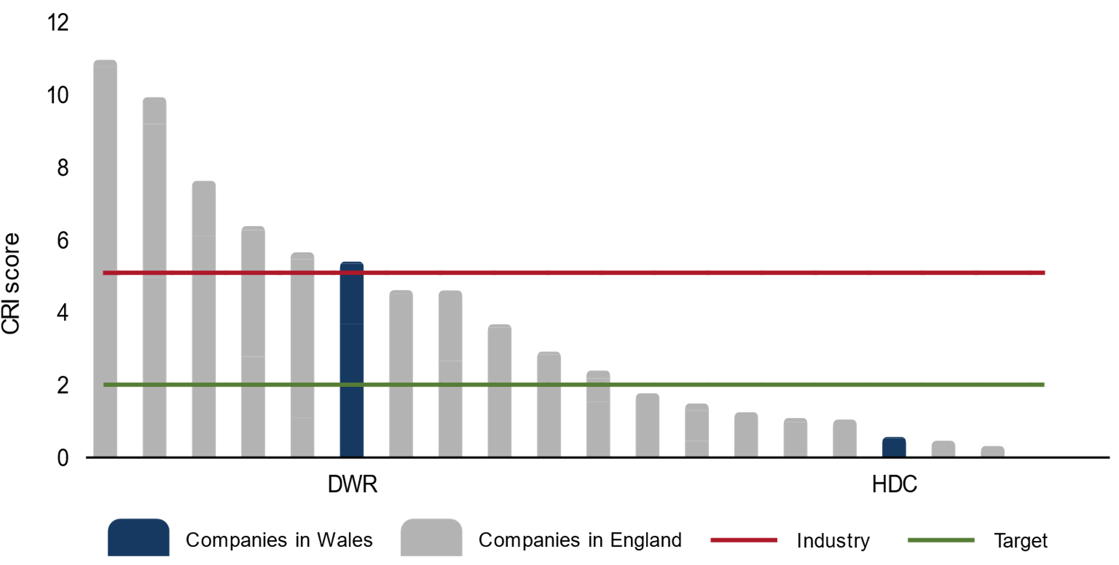
CRI Wales

Slide 53
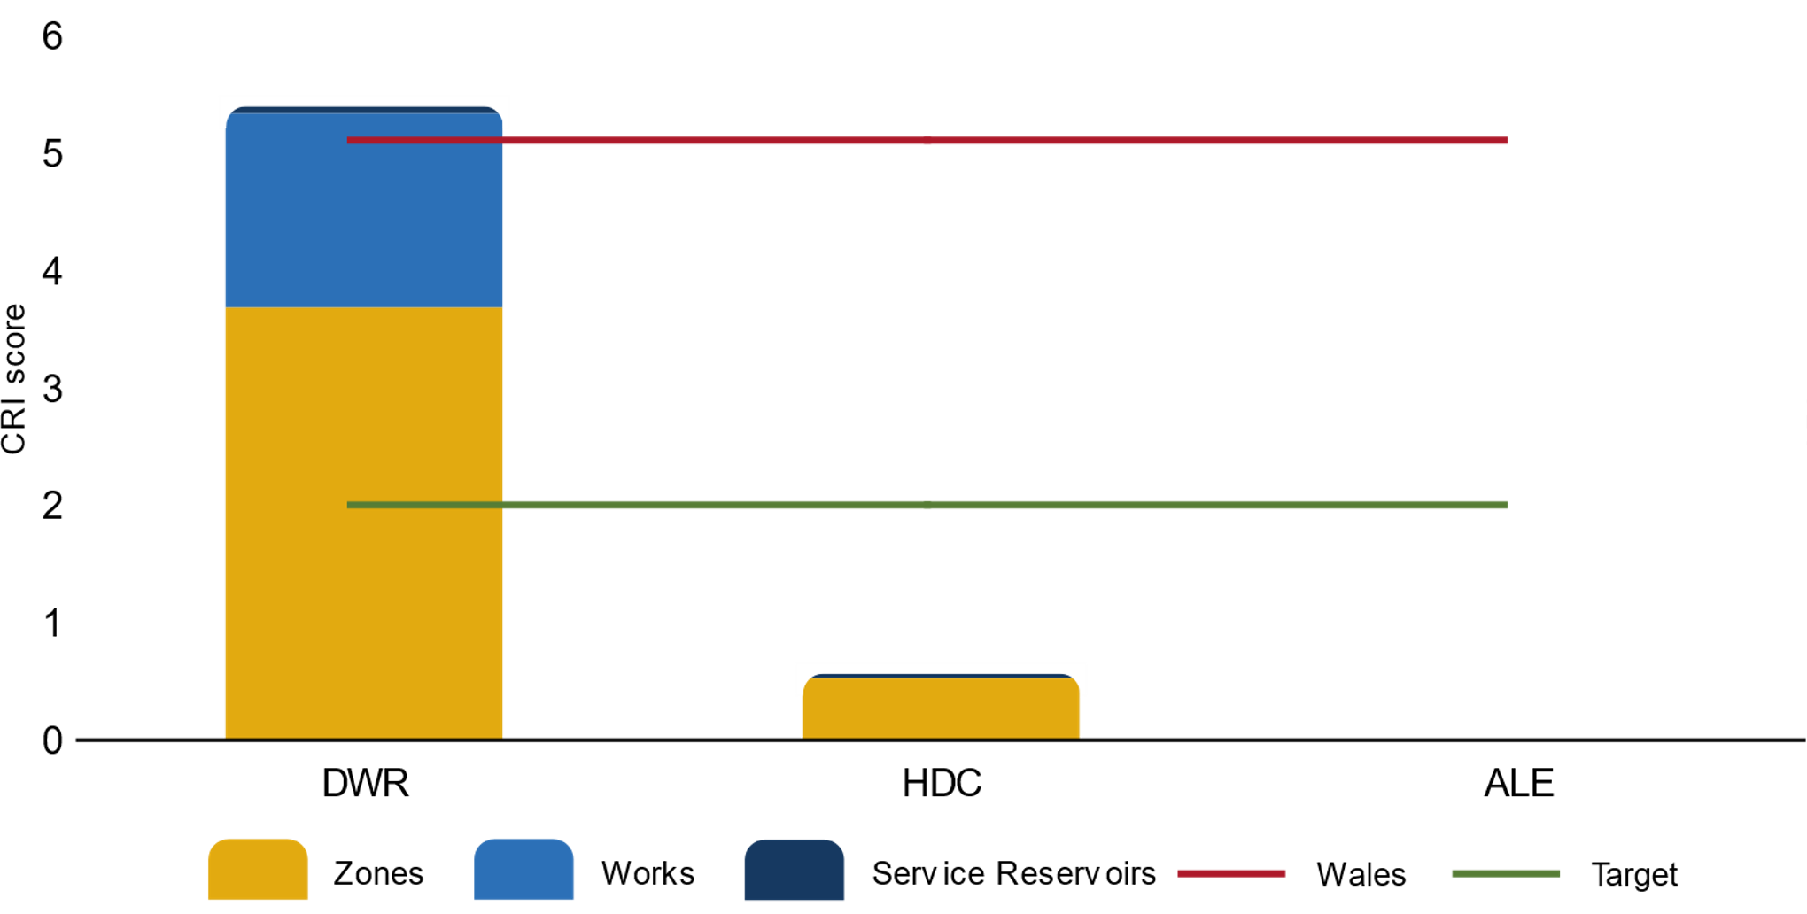
CRI Wales

Slide 54
CRI by parameter- Wales

Slide 55
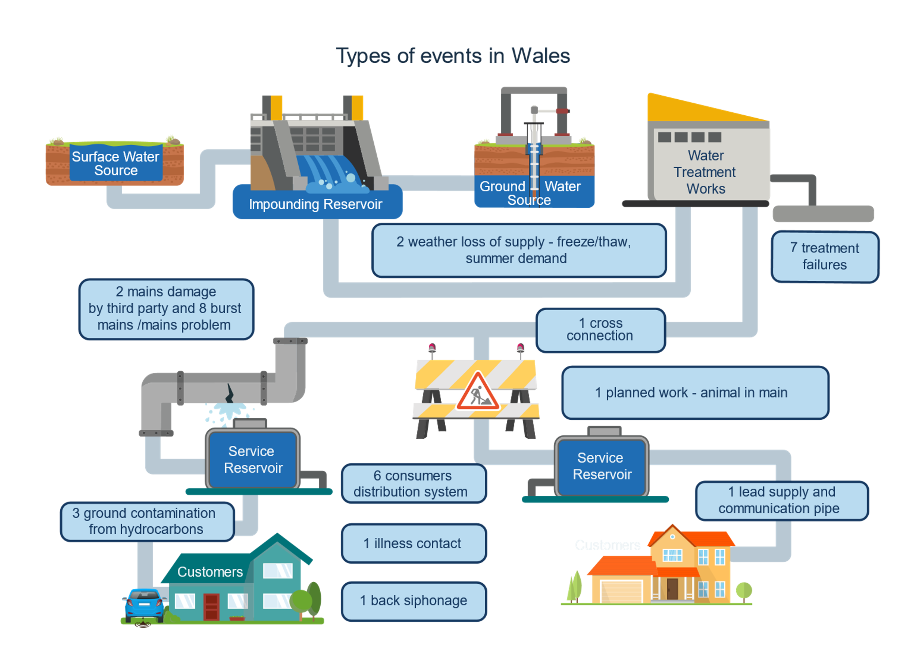
Water quality events
Notes:
TL: 33 events (31 DWR) but 2/3 are part of the company system and should be mostly within their control.
BP:
There was one collective event in the wider industry and that was the Freeze/Thaw event
Primarily this impact was seen in rural areas and, in particular, West Wales (Mid & South Ceredigion), The Gwendraeth Valley (Carmarthenshire) and Herefordshire/Mid Wales.
Planning for the expected cold weather started on Friday 9 December 2022 with a preparation call to discuss the incoming weather risks followed by a series of calls through the week to review resource availability, storage position, weather forecasts with requests to the Dŵr Cymru volunteer force made for people to make themselves available on Sunday and Monday 18/19 December for bottled water deliveries or tinkering, if required.
Six bottled water stations were set up across West Wales which consisted of bottled water and in some cases Arlington tanks. Pallets of bottled water were also delivered to a number of individual areas where reports of low pressure no water were reported.
The Inspectorate welcomes the proactive planning of the event, with the initial meeting held on Friday 9 December 2022 to discuss incoming weather risks as well as the proactive dropping of bottled water to customers on the PSR lists and the company’s early engagement with staff to ensure sufficient resources allocated.

Slide 56
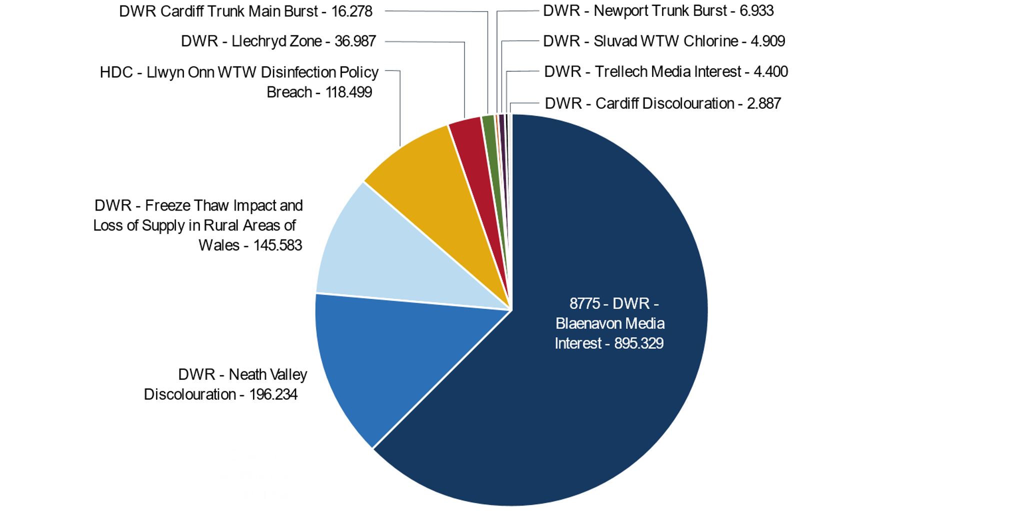
High scoring events

Slide 57
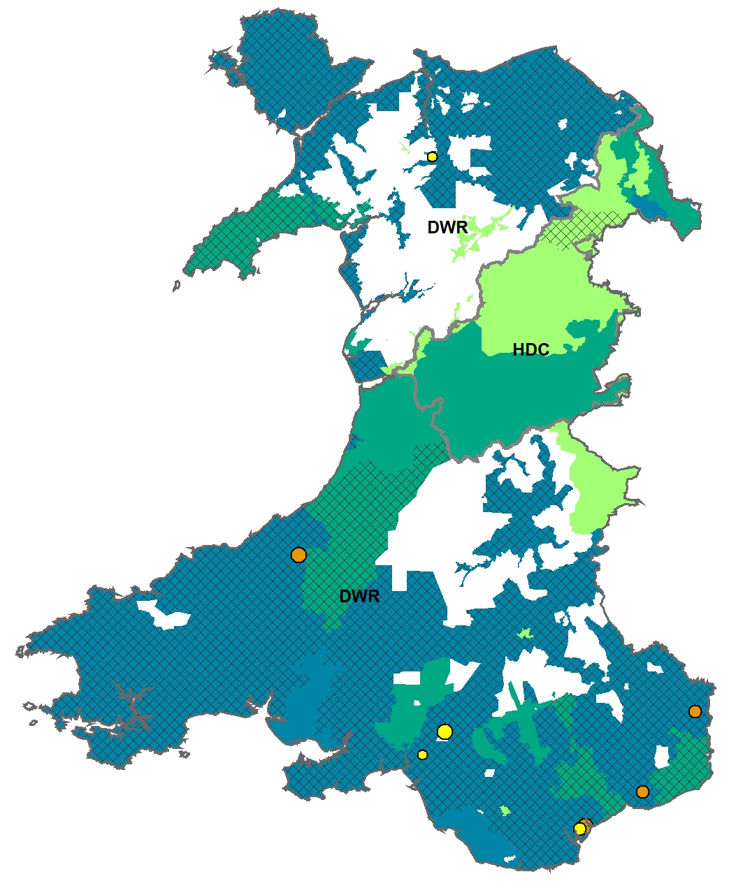
High risk zones for discolouration in Wales, 2022
Betws-Y-Coed, January 2022
Neath Valley
July – September 2022
Cimla
July 2022
Cardiff,
July 2022

Slide 58
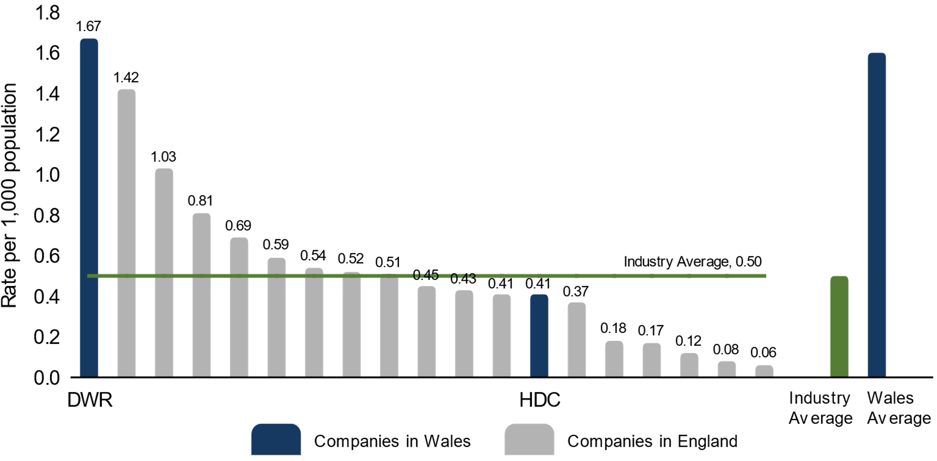
Discolouration rate 2022

Slide 59
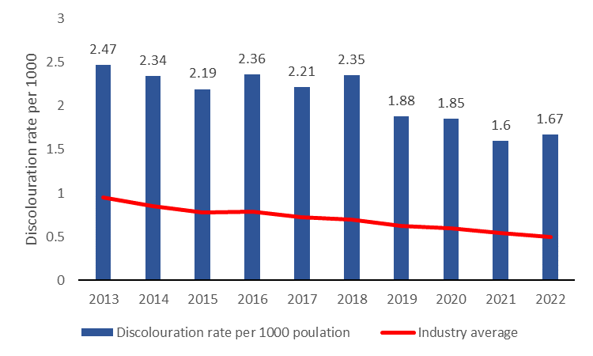
DWR discolouration rate per 1000

Slide 60
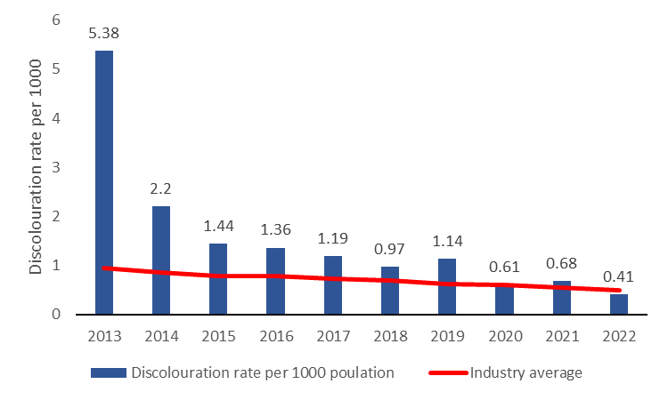
HDC discolouration rate per 1000

Slide 61
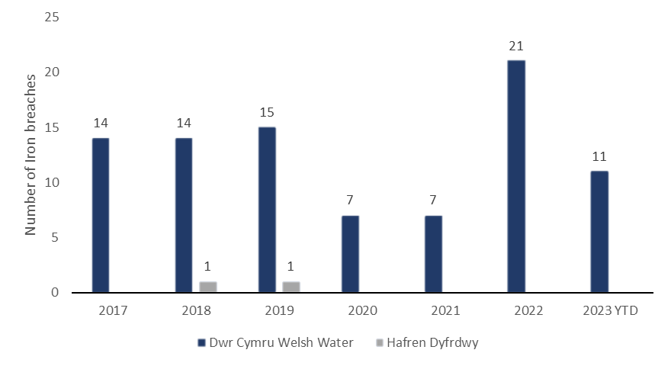
Wales area Iron breaches

Slide 62
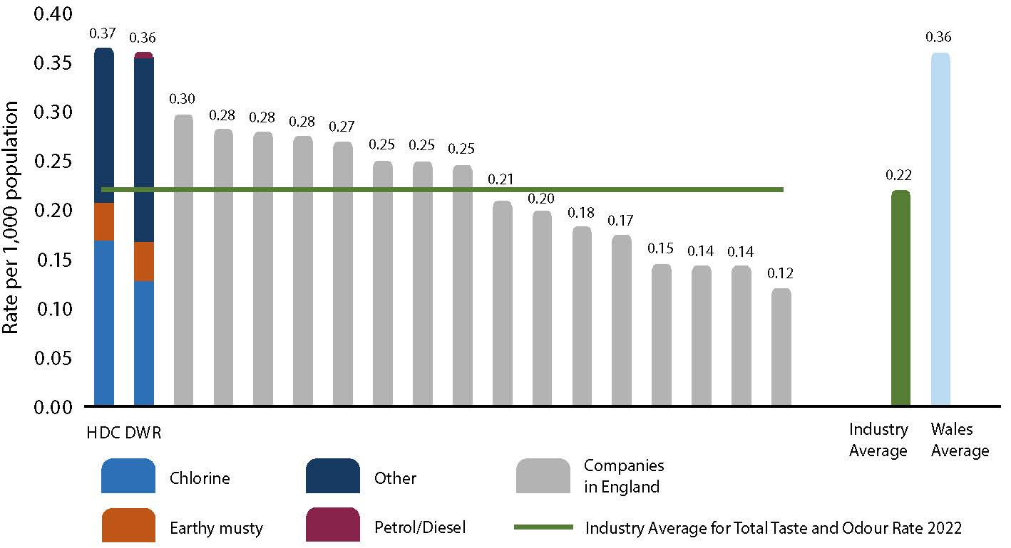
Taste and odour rate 2022

Slide 63
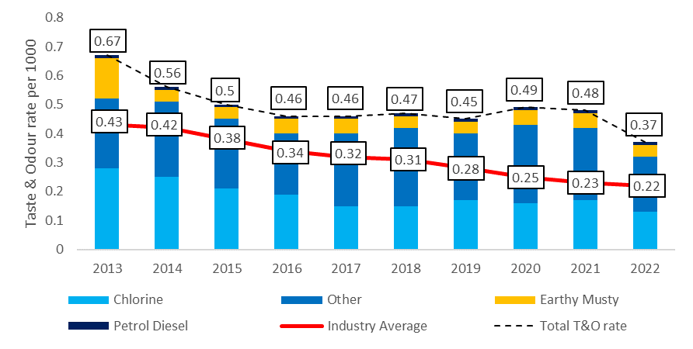
DWR taste and odour contacts

Slide 64
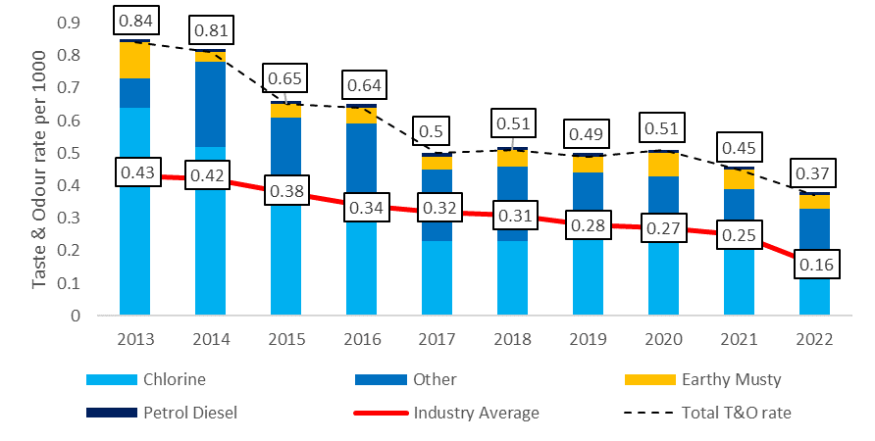
HDC taste and odour contacts

Slide 65
Water Quality Impacts: Asset Health and Rain
According to the Meteorological Office, in 2019 Cheshire received more than twice the average rainfall in a month (219%). Other counties in central and northern England, including Lancashire, Staffordshire, Derbyshire and Leicestershire, also received more than one-and-a-half times the month’s typical rainfall
In 2019 out of the 96 coliform failures during the year, 50 were detected in the third quarter of the year in Service Reservoirs. Such a notable number reflected the meteorological conditions during this period.
Notes:
Optional slide
Following on from the previous slide – photo of the new service reservoir under construction at Pengarnddu (pronounced Pengarnthi)

Slide 66
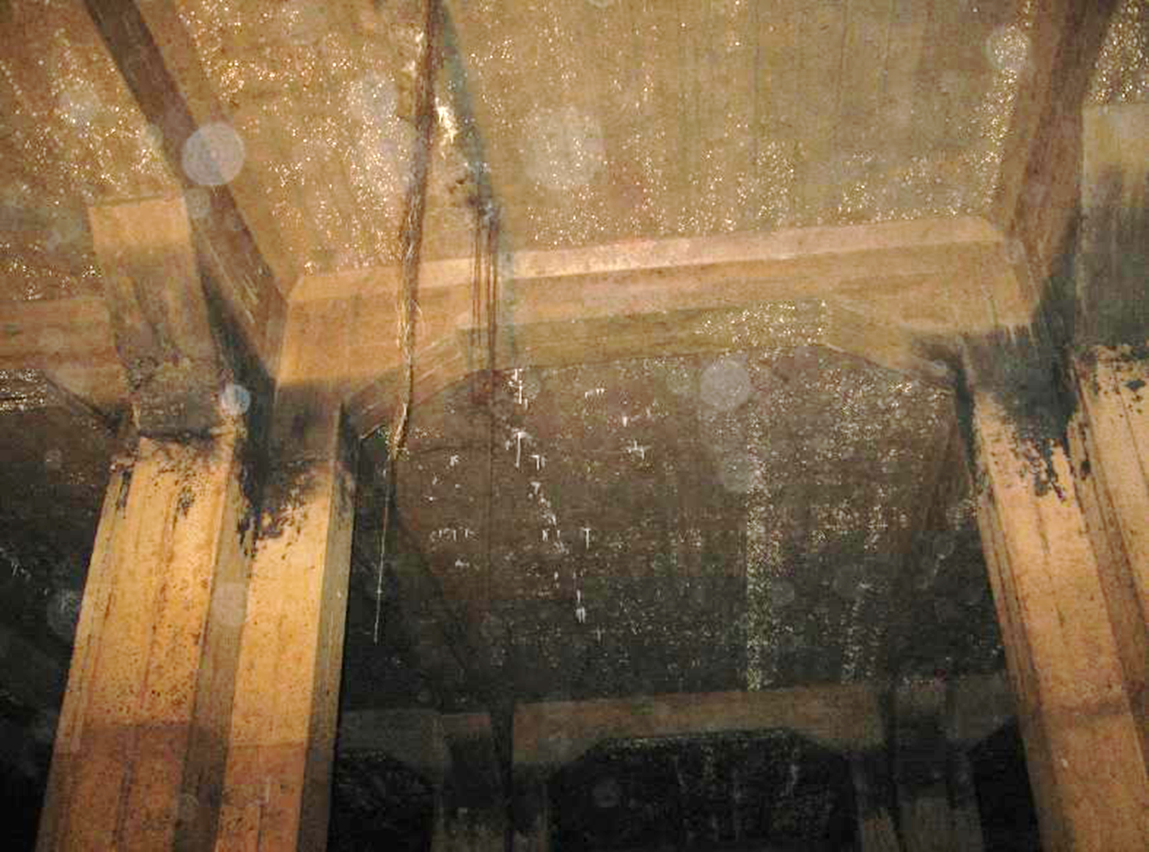
Asset Inundation

Slide 67
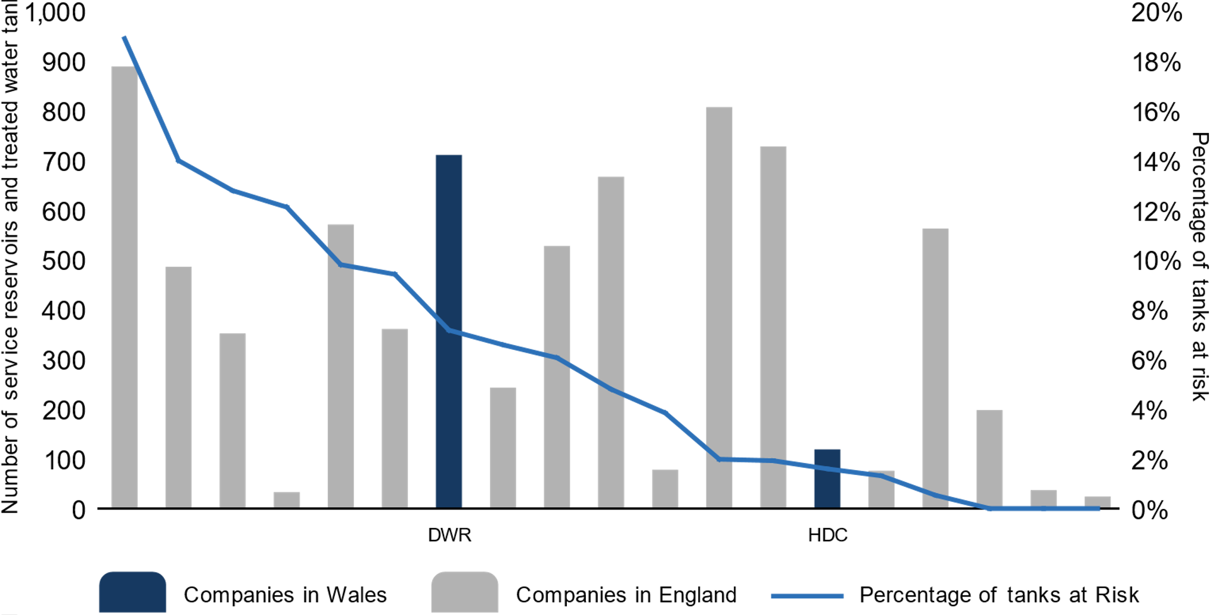
Service Reservoirs and Tanks
Notes:
Optional slide
Following on from the previous slide – photo of the new service reservoir under construction at Pengarnddu (pronounced Pengarnthi)

Slide 68
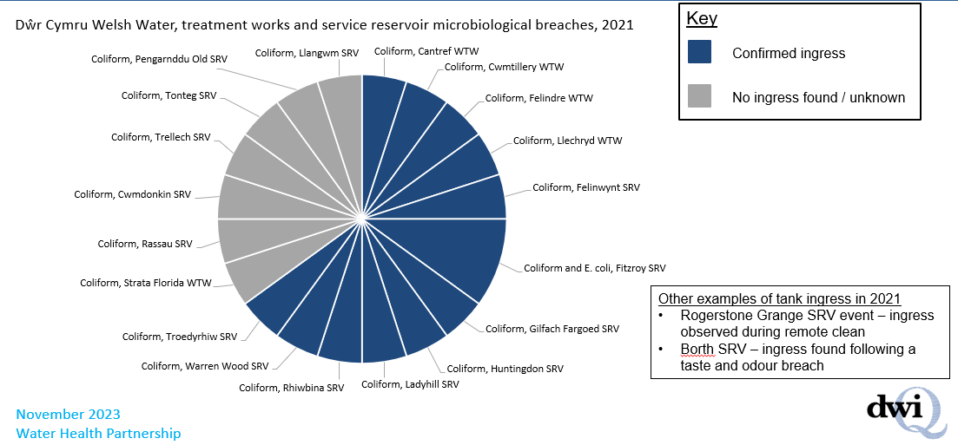
Welsh Water Service Reservoir Integrity

Slide 69
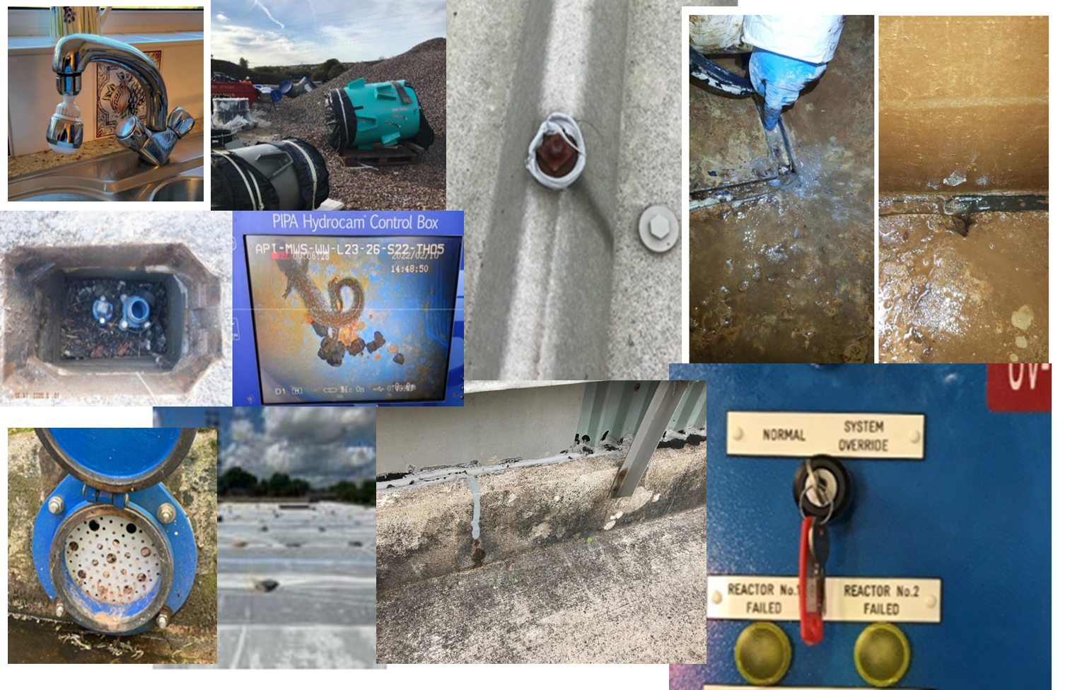
Asset Risks

Slide 70
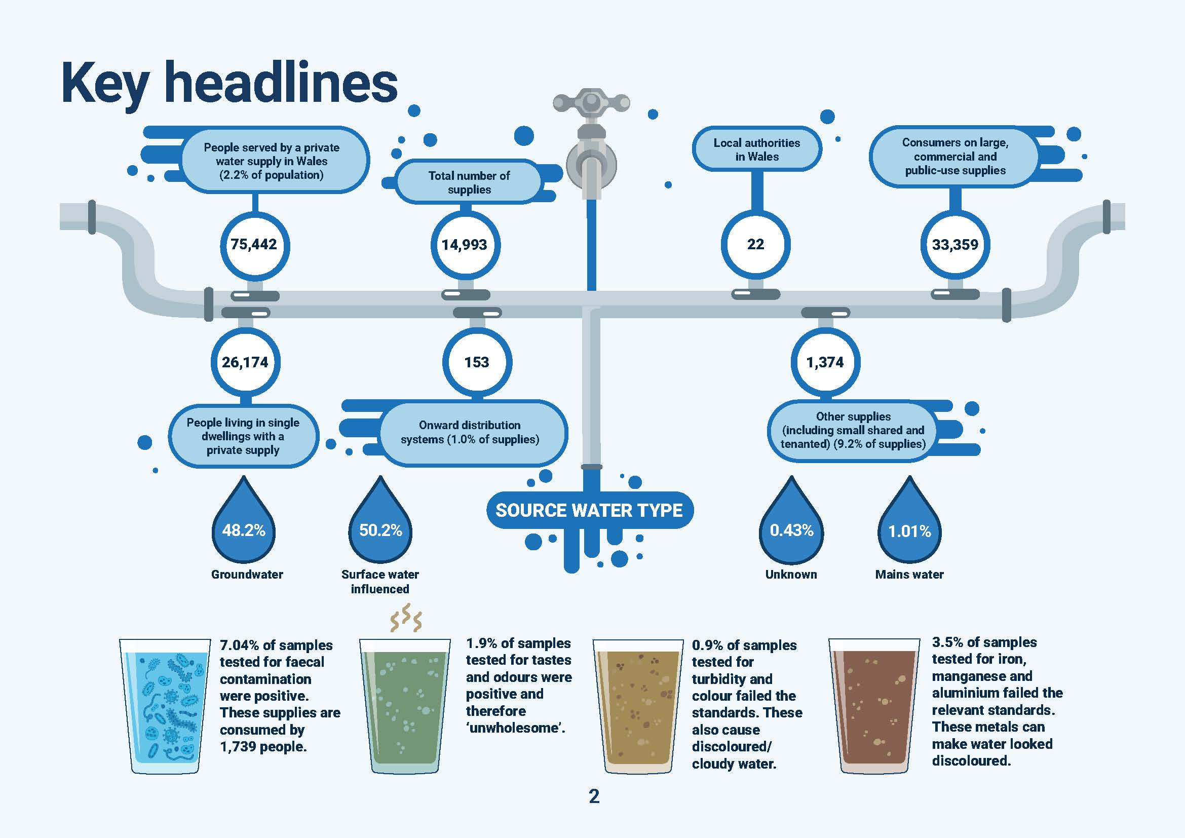
Private Water Supplies Overview

Slide 71
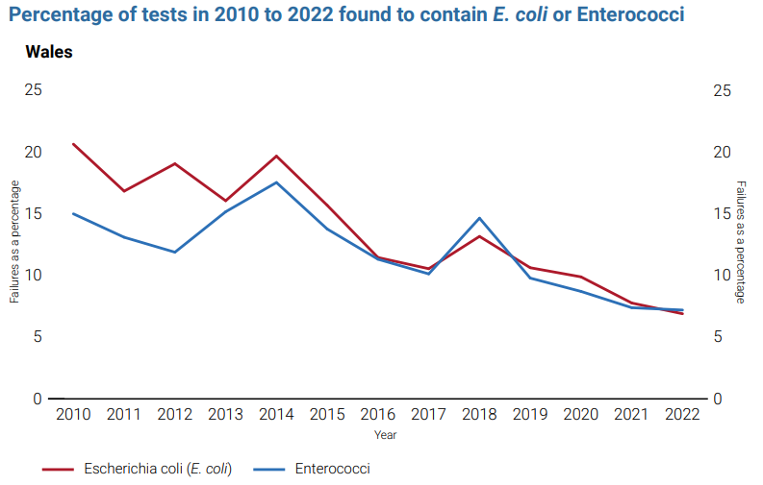
Private Water Supplies
Notes:
Note on the reduction of failures but with caveat
Overlay public supply failures
Facts on the stats e.g frequency of sampling, properties which are not sampled at all etc.

Slide 72
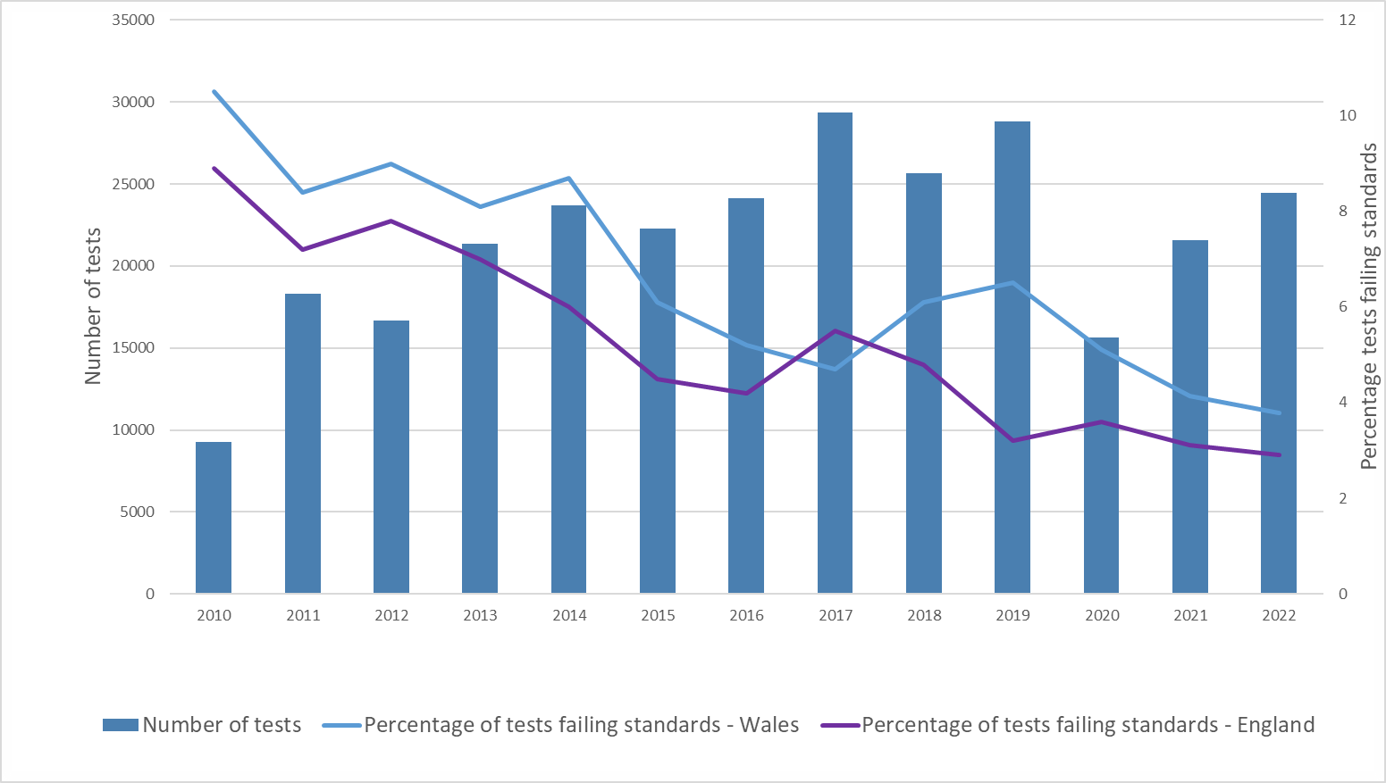
Private Water Supplies

Slide 73
Private Water Supplies Negative Health Effects
Notes:
No. of pesticide tests - 986 for Wales in 2022
No. of lead tests - 1038 for Wales in 2022

Slide 74
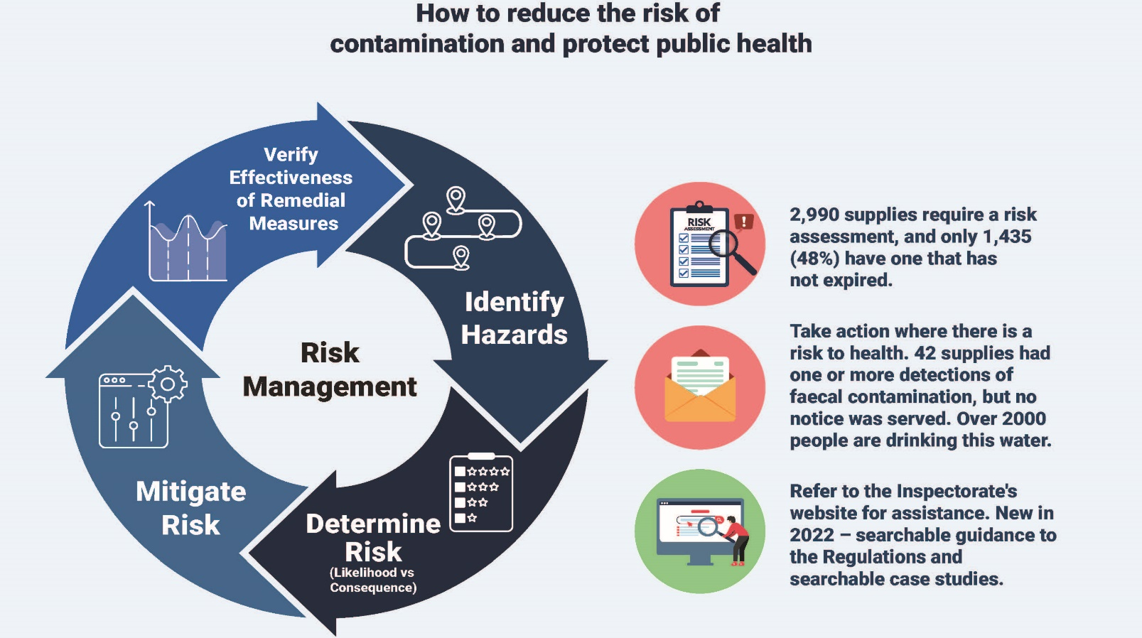
Private Water Supplies & RAs

Slide 75
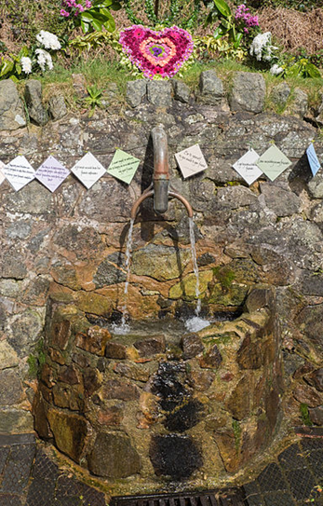
Hayslad waterspout
The wells in Malvern have provided a source of fresh drinking water for centuries.
Since at least the Middle Ages, Malvern spring water has been valued for its purity and health-giving properties.
In Victorian times, the town became famous for its water, being described as containing "nothing at all".

Slide 76
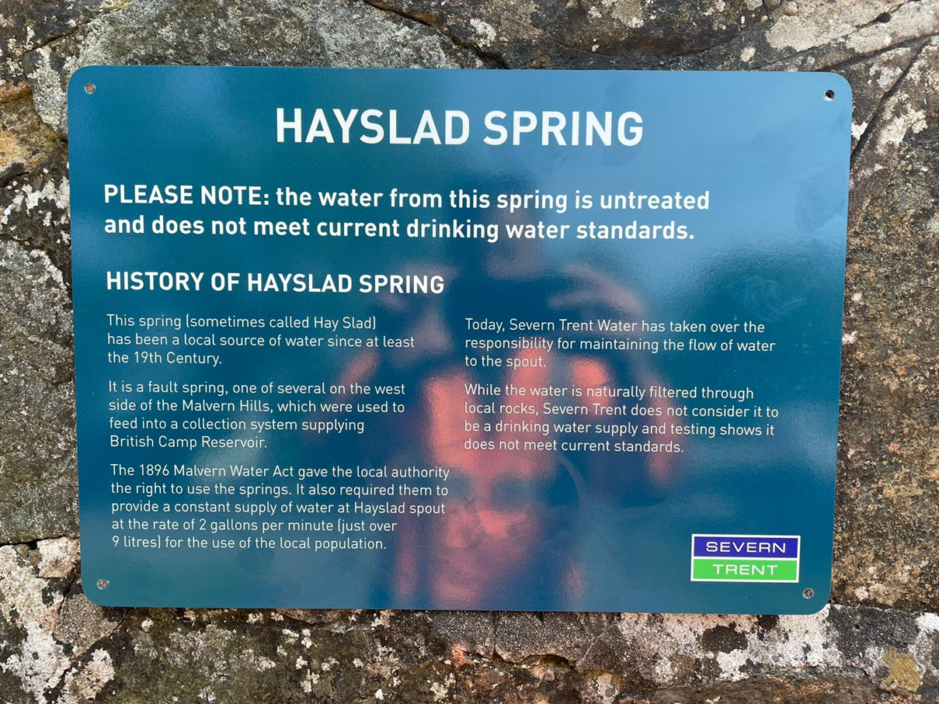
Hayslad waterspout
Hayslad spout is on West Malvern Road and is piped directly from three natural springs on the hillside to the south of the West of England.
Supply regulated as a PWS since 2009 until 2021.
LA served a reg 18 notice
Relevant person refuted responsibility for remedial work, citing owner to be Severn Trent Water. LA could not substantiate.
LA approached DWI to intervene
Lawyers employed to establish legal facts to provide answers.
1905 Malvern Water Act.
The supply is a Severn Trent asset.

Slide 77
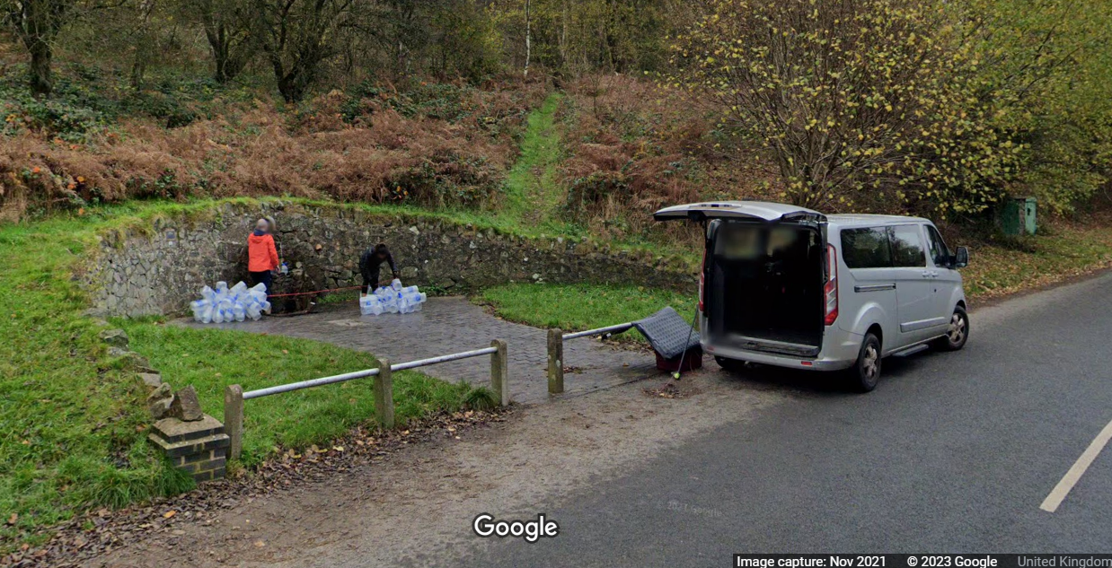
Hayslad waterspout
“It arises from an obligation (which has subsequently passed to STW) imposed by Section 26(1) Malvern Water Act 1905.”
Although the supply is provided by a water undertaker, it is not intended for domestic purposes.
“the obligation was to continue to provide a historic ‘supply of water’, rather than a domestic supply.
Conservators want to promote the “pure” quality of the water.
Signs deterring use keep being ripped down!

Slide 78
Aysdalegate Cottages (Old Ironstone Mine)
9 Cottages on a PWS from spring on nearby farm with no deeds/covenants.
Supply failed 9 times for E. coli/Ent/Coliforms and Tadpoles!
Reg 18 notice served for Boil Water Advice
£756 for survey to establish cost for connection to mains which is 1km away.
Potential solutions:
Mains Supply
PWS Treatment/New B/H
POU Devices
Tank Refill
Notes:
NWL waiving the fee for the survey. Westminster Hall debate
DEFRA said no funding available to help properties connect.

Slide 79
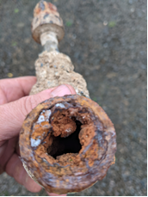
Barham Road, Trecwn, 2018 - 2023
Former MoD site of 32 properties. Properties responsible for main.
Foul taste, odour and discolouration.
Iron levels at 1900 µg/L.
Insufficient due to CI pipe deterioration and collapse (contingency plan with Welsh Water).
Connection to mains explored but was too expensive.
LA took steps to do the works in default and put a charge on the properties.
LA concurrently applied to DHLUC's Shared Prosperity Fund and in 2023 was awarded £470,000.
LA + consultancy will deliver the project to connect to Welsh Water's main at no cost to the consumers.
Consumers will become Welsh Water customers.

Slide 80
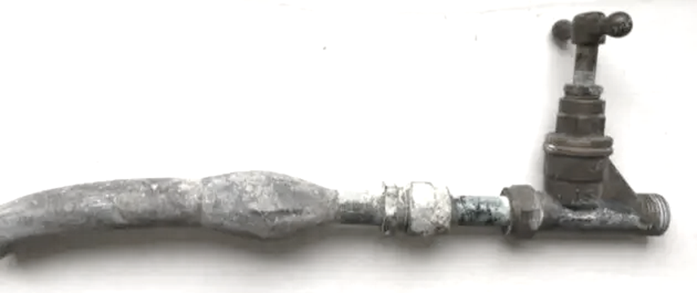
Drinking water quality
Risks to Planning
Climate Change
Drought/Rain/Pollutants/Deterioration/Concentration
Resource Availability/Recycling/Desalination/Grey/Transfers
Asset Adaptability
Continuing and new risks
PFAS/EDC/Pharmaceuticals/Microplastics/Novel Compounds
Nickel/Lead/EDD
Source to Tap Planning
Catchment Risks: Algae/Metals/Transfers
Asset Health: WTW/SR/Network Mains (Condition/Material/Suitability)
Supply Resilience
Asset Capability/Storage/Distribution/Power/Security/Alternative Supplies
Notes:
JIM

Slide 81
Drinking Water Inspectorate
 : dwi.enquiries@defra.gov.uk
: www.dwi.gov.uk

Slide 82
Exploring health risks and impacts of using private water supplies (PWS), in a changing climate
Archwilio risgiau iechyd ac effeithiau defnyddio cyflenwadau dŵr preifat (CDP), mewn hinsawdd sy'n newid
Anna Schwappach a Kristian James

Slide 83
Background to this work
Cefndir y gwaith hwn

Slide 84
Nod y gwaith hwn
Pa dystiolaeth sydd ar gael am risgiau ac effeithiau ar iechyd defnyddio CDP yng Nghymru?
Pan fyddwn yn dod o hyd i dystiolaeth, beth mae hyn yn ei ddweud wrthym am risgiau ac effeithiau ar iechyd heddiw ac yn y dyfodol?
Beth ddylen ni ei wneud i wella ein dealltwriaeth o’r risgiau a’r effeithiau ac i ddiogelu iechyd defnyddwyr CDP yng Nghymru?
Aim of this work
What evidence is there on health risks and impacts of using private water supplies (PWS) in Wales?
Where we find evidence, what does this tell us about current and future health risks and impacts?
What should we do to increase our understanding of risks and impacts and to protect the health of PWS users in Wales?

Slide 85
Why is this needed?
Pam mae angen hyn?
2.2% of population – potential for significant public health implications
Are there inequalities in health risks and impacts?
How will a changing climate affect health risks and impacts?
Complements work of other partners
2.2% o'r boblogaeth – potensial ar gyfer goblygiadau iechyd y cyhoedd sylweddol
A oes anghydraddoldebau o ran y risgiau a’r effeithiau ar iechyd?
Sut y bydd hinsawdd sy'n newid yn effeithio ar y risgiau a’r effeithiau ar iechyd?
Mae’n ategu gwaith partneriaid eraill

Slide 86
What are we doing?
Beth ydyn ni’n ei wneud?
Iechyd Cyhoeddus Cymru (ICC) yn cynnal adolygiad cyflym:
Ar draws ein sefydliad
Croesawu mewnbwn gan gydweithwyr y tu allan i ICC
Adolygiad cyflym o’r dystiolaeth:
Llenyddiaeth gyhoeddedig
Data Arolygiaeth Dŵr Yfed (DWI)
Cofnodion diogelu iechyd ICC
PHW undertaking a rapid review:
Across our organisation
Welcome inputs from colleagues outside PHW
Rapid review of the evidence:
Published literature
DWI data
PHW health protection records

Slide 87
What we have found so far….
Yr hyn rydyn ni wedi'i ddarganfod hyd yn hyn….

Slide 88
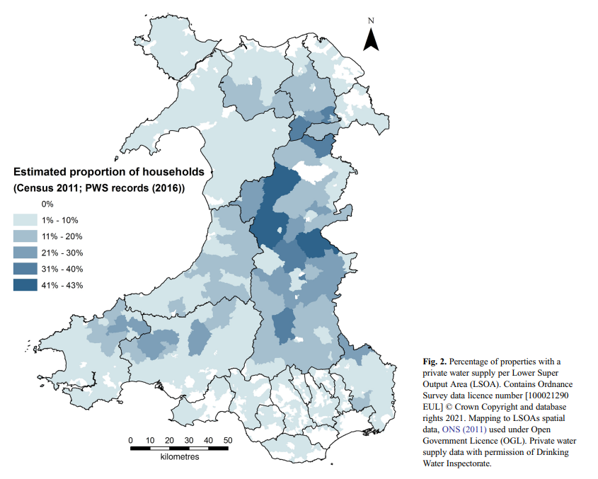
Yr hyn a wyddom am CDP
2.2% o'r boblogaeth – tua 75,442 o unigolion (DWI, 2023)
Hyd at 43% o eiddo mewn rhai ardaloedd (Farr et al, 2022)
O’r CDP sy’n ddŵr daear, mae 97% yn cael eu cynnal gan ddyfrhaenau eilaidd
2,990 o gyflenwadau angen asesiad risg; dim ond 48% sydd ag asesiad risg sydd heb ddod i ben
Ond mae’r union nifer, lleoliad a’r bregusrwydd yn anhysbys
What we know about PWS
2.2% of population – approx. 75,442 individuals (DWI, 2023)
Up to 43% of properties in some areas (Farr et al, 2022)
Of ground-water PWS, 97% supported by secondary aquifers
2,990 supplies requiring risk assessment; only 48% with risk assessment not expired
But, exact number, location and vulnerabilities unknown
Farr et al (2022) Revealing the importance of groundwater for potable private supplies in Wales.

Slide 89
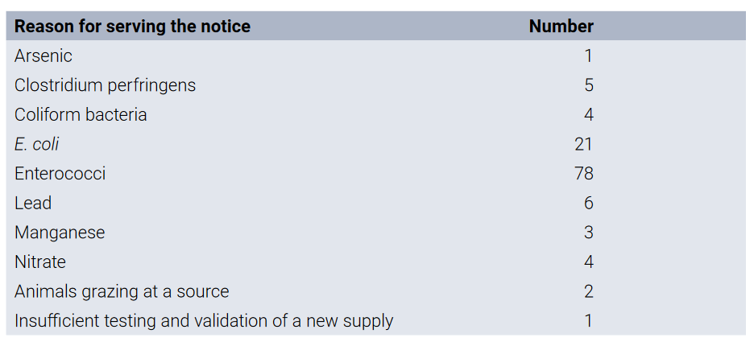
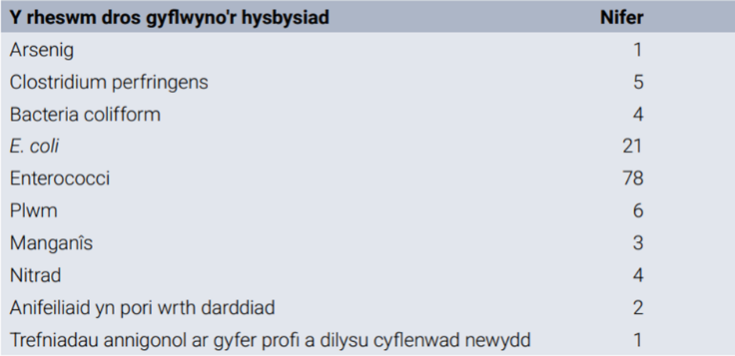
Findings so far on microbiological contamination….preliminary
Canfyddiadau hyd yma ar halogiad microbiolegol…. rhagarweiniol
Some (but limited) evidence: research; DWI and PHW
Routine parameters are indicators of contamination
Pathogen detection (e.g. campy and crypto) and GI illness in special studies
Impacts in rural areas
Peth tystiolaeth (ond cyfyngedig): ymchwil; DWI ac ICC
Mae paramedrau arferol yn ddangosyddion halogiad
Canfod pathogenau (e.e. campy a crypto) a salwch gastroberfeddol mewn astudiaethau arbennig
Effeithiau mewn ardaloedd gwledig
XXXXX
(DWI, 2023)
(DWI, 2023)
xxxxxxxxxxxxx

Slide 90
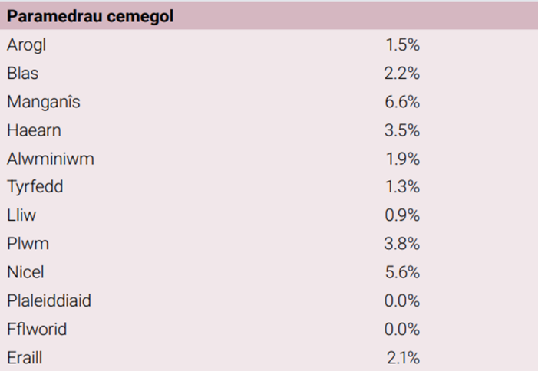
Findings so far on chemical contamination….preliminary
Canfyddiadau hyd yn hyn ar halogiad cemegol…. rhagarweiniol
Very limited evidence: research; DWI and PHW records
Contamination (e.g. aluminium and manganese)
Known impacts of chemical exposure
Tystiolaeth gyfyngedig iawn: ymchwil; Cofnodion DWI ac ICC
Halogiad (e.e. alwminiwm a manganîs)
Effeithiau hysbys dod i gysylltiad â chemegau
(DWI, 2023)
(DWI, 2023)

Slide 91
Findings so far on climate change….preliminary
Canfyddiadau hyd yn hyn ar newid hinsawdd….rhagarweiniol
Ychydig iawn o dystiolaeth sydd ar gael
Digwyddiadau glaw trwm:
Ansawdd microbiolegol cyflenwadau
Cyfnodau o sychder a phrinder:
132 o achosion o brinder yn 2018 (Farr et al, 2022)
Crynodiad o gemegau
Very little evidence available
Heavy rainfall events:
Microbiological quality of supplies
Drought periods and insufficiency:
132 cases of insufficiency in 2018 (Farr et al, 2022)
Concentration of chemicals
PHW data (GI illness) - camplylobacter and then cryptosporidium

Slide 92
What is this beginning to tell us….
Beth mae hyn yn dechrau ei ddweud wrthon ni….

Slide 93
Meysydd sy'n dod i'r amlwg: Yng nghyd-destun hinsawdd sy'n newid a meddwl am iechyd
Emerging areas:
In the context of a changing climate and thinking about health
Understanding PWS locations, their water sources and vulnerabilities
Developing systems to understand health impacts
Quantity, quality and accessibility of publicly available information on PWS
Specific considerations for tourism sector
Deall lleoliadau CDP, eu ffynonellau dŵr a'u bregusrwydd
Datblygu systemau i ddeall yr effeithiau ar iechyd
Maint, ansawdd a hygyrchedd yr wybodaeth sydd ar gael i'r cyhoedd ar CDP
Ystyriaethau penodol ar gyfer y sector twristiaeth

Slide 94
I’w drafod
For discussion
Eich barn ar ein meysydd newydd…
Eich barn ar unrhyw dystiolaeth arall mae’n bosibl nad ydym yn ymwybodol ohoni…
Symud y gwaith hwn ymlaen gyda’n gilydd…
Your thoughts on our emerging areas…
Your thoughts on any other evidence we might be missing…
Taking this work forward together…

Slide 95
Meysydd sy'n dod i'r amlwg: Yng nghyd-destun hinsawdd sy'n newid a meddwl am iechyd
Emerging areas:
In the context of a changing climate and thinking about health
Understanding PWS locations, their water sources and vulnerabilities
Developing systems to understand health impacts
Quantity, quality and accessibility of publicly available information on PWS
Specific considerations for tourism sector
Deall lleoliadau CDP, eu ffynonellau dŵr a'u bregusrwydd
Datblygu systemau i ddeall yr effeithiau ar iechyd
Maint, ansawdd a hygyrchedd yr wybodaeth sydd ar gael i'r cyhoedd ar CDP
Ystyriaethau penodol ar gyfer y sector twristiaeth

Slide 96
Next steps…
Y camau nesaf...

Slide 97
Beth nesaf?
What next?
Bydd ICC yn cwblhau ei hadroddiad
Mynd â'n canfyddiadau i’r Bartneriaeth Dŵr ac Iechyd ac i Lywodraeth Cymru
Ystyried, gyda’n gilydd, sut y gallwn fwrw ymlaen â’n hargymhellion ac unrhyw waith arall
.
PHW will finalise our report
Take our findings to Water Health Partnership and to Welsh Government
Consider, together, how we can take our recommendations and any other work forward

Slide 98
Gweithio gyda'n gilydd i greu Cymru iachach Working together for a healthier Wales
Diolch yn fawr
Ar ran/ on behalf of:
Siôn Lingard (Tîm Diogelu Iechyd
Health Protection); Professor Rachel Chalmers (Microbioleg/ Microbiology); Louis Whelan (Iechyd Cyhoeddus Amgylcheddol/
Environmental Public Health)
Diolch i/ thanks to:
ICC Gwasanaeth Tystiolaeth/ PHW Evidence Service

Slide 99
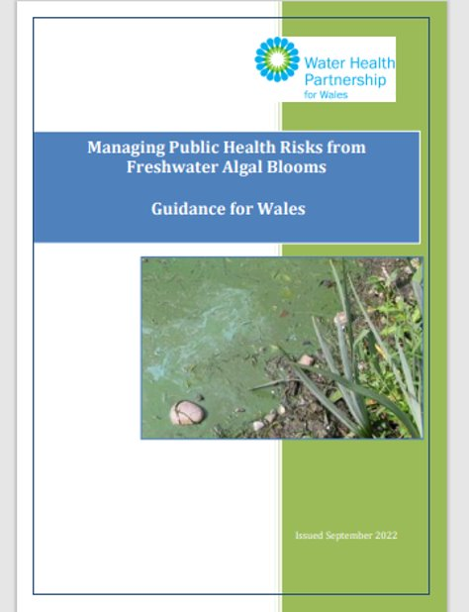
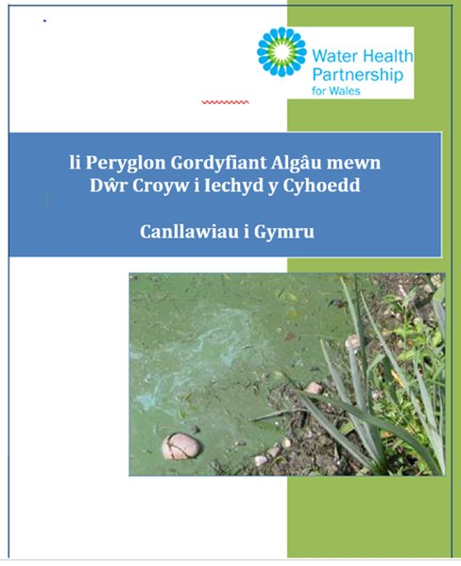
li Peryglon Gordyfiant Algâu mewn Dŵr Croyw i Iechyd y Cyhoedd Canllawiau i Gymru
Ar gael ar wefan Partneriaeth Iechyd Dŵr Cymru
Managing Public Health Risks from Freshwater Algal Blooms – Guidance for Wales
Available at WHP website

Slide 100
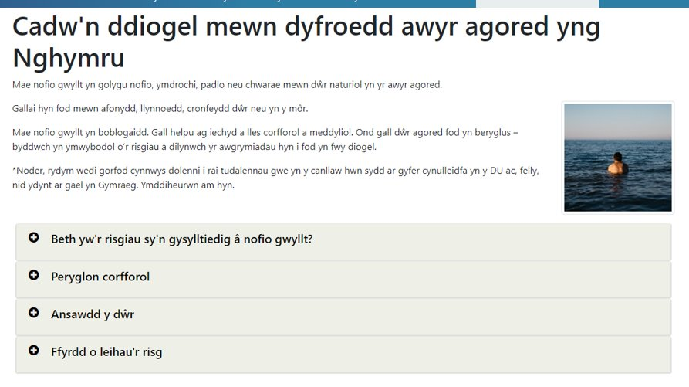
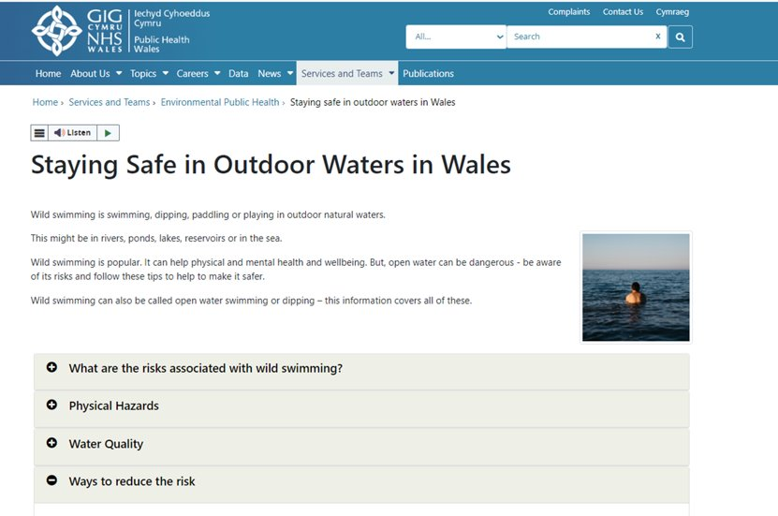
https://icc.gig.cymru/gwasanaethau-a-thimau/iechyd-cyhoeddus-amgylcheddol/cadwn-ddiogel-mewn-dyfroedd-awyr-agored-yng-nghymru/
https://phw.nhs.wales/services-and-teams/environmental-public-health/staying-safe-in-outdoor-waters-in-wales/

Slide 101
Break Return to this room at 15:05 please

Slide 102
Q&A session and feedback

Slide 103
Closing remarks
Sharon Evans
Director of Quality, Policy and Compliance, Dŵr Cymru Welsh Water
Chair of Water Health Partnership Steering Group

Slide 104
Event Close
Thank you for attending and your participation
We will be producing a summary of today’s event including copies of presentation slides and a summary of questions / answers on slido questions not covered
Don’t forget to pick up your CPD form

